Slide 1
Biodiversity in US National Parks
Project 3
Group 4 - Patricia Colomer, Hibaa Aldubai, Astha Nayak, Abraham Ofolu, Siyuan Liang and Samanthi Jayaranthna
Notes:
Samanthi

Slide 2
Contents
Introduction
Data Source
Data Transformation and Loading
Planning
Home Page
Parks Page
Species Page
Analysis
Conclusions
Demo
Notes:
Samanthi

Slide 3
What is Biodiversity?
Bio = Life
Diversity = Variety
Biodiversity is the name we give to the variety of life on our planet, which is the result of billions of years of evolution. It includes all species of animals and plants, and the natural systems that support them.
The US National Parks are home to a fascinating range of animals and plants, many of which are rare and protected.
However, biodiversity also refers to the ecosystems in our forests, wetlands, mountains, lakes, rivers and agricultural landscapes.
Millions of plant and animal species maintain these ecosystems, creating oxygen that we breathe, providing food for us to eat and ultimately ensuring a sustainable planet for future generations.
They are essential to human survival.
Notes:
Astha

Slide 4
USA National Parks
The United States has 56 national parks.
These are designated protected areas operated by the National Park Service. National parks are designated for their natural beauty, unique geological features, diverse ecosystems and recreational opportunities.
The national parks are found within 30 states and stretch for millions of acres through arid deserts, forests, icy mountains, and the crystalline waters of the tropics.
The 56 national parks in the United States draw millions of visitors a year to unique natural wonders and unforgettable terrains.
Notes:
Patricia

Slide 5
Our Data
2 CSV files - Parks and Species
We obtained our data from Biodiversity in National Parks | Kaggle
We selected these data files to learn more about the National Parks in the US, where they are located and the species that live within them.
When researching the data, we learnt many things including loss of plant and animal species over time has always occurred, but the current pace of extinction is roughly 1,000 times higher than the natural rate.
Reasons for this include climate change, pollution, habitat destruction, over-exploitation of natural resources, introduction of invasive species and an increase in intensive agriculture.
Notes:
Abraham

Slide 6

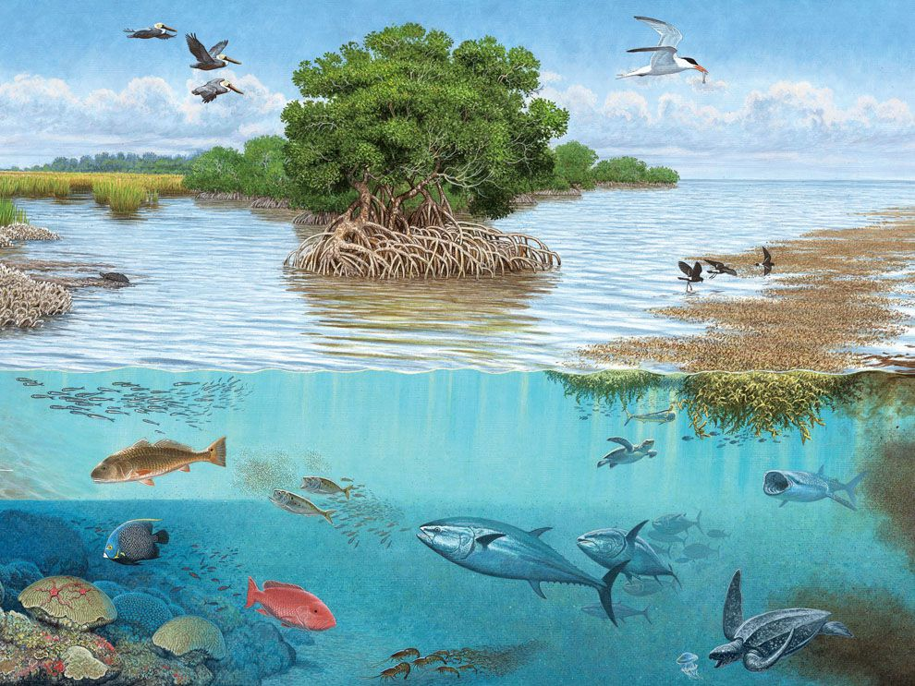

Did you know…
There are three types of biodiversity…
Diversity of Species
Diversity of Ecosystem
Diversity of Genes
Notes:
Stephen

Slide 7
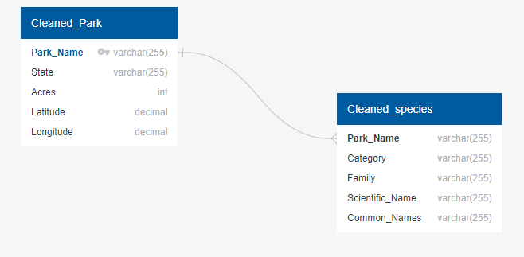
Data Transformation and Loading
After downloading our data, we cleaned both files by removing any columns that did not provide us with any relevant information.
We also removed any rows that had missing data.
We then used SQL to housed our cleaned information within 2 tables.
Technologies used: Python 3 and SQL
Notes:
Stephen

Slide 8
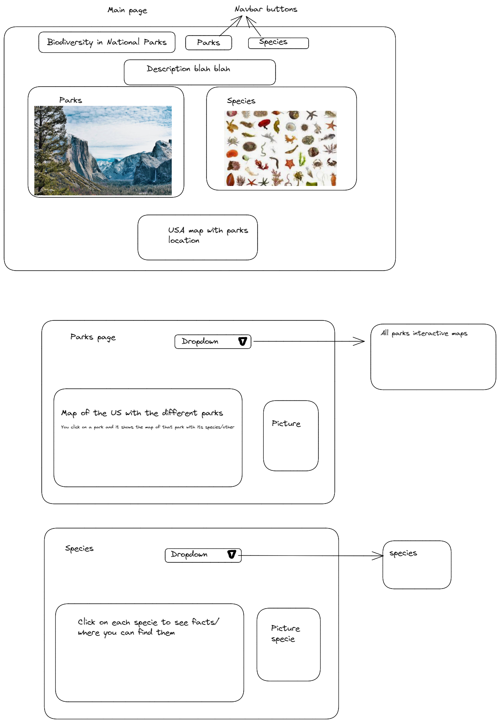
Planning our Visualisations
We started off by discussing at what information we can get out of our data and the different ways we can display and visualise the data.
We then discussed our webpages and how many we wanted and the layout of these pages.
Discussion
Sketch
Notes:
Patricia

Slide 9
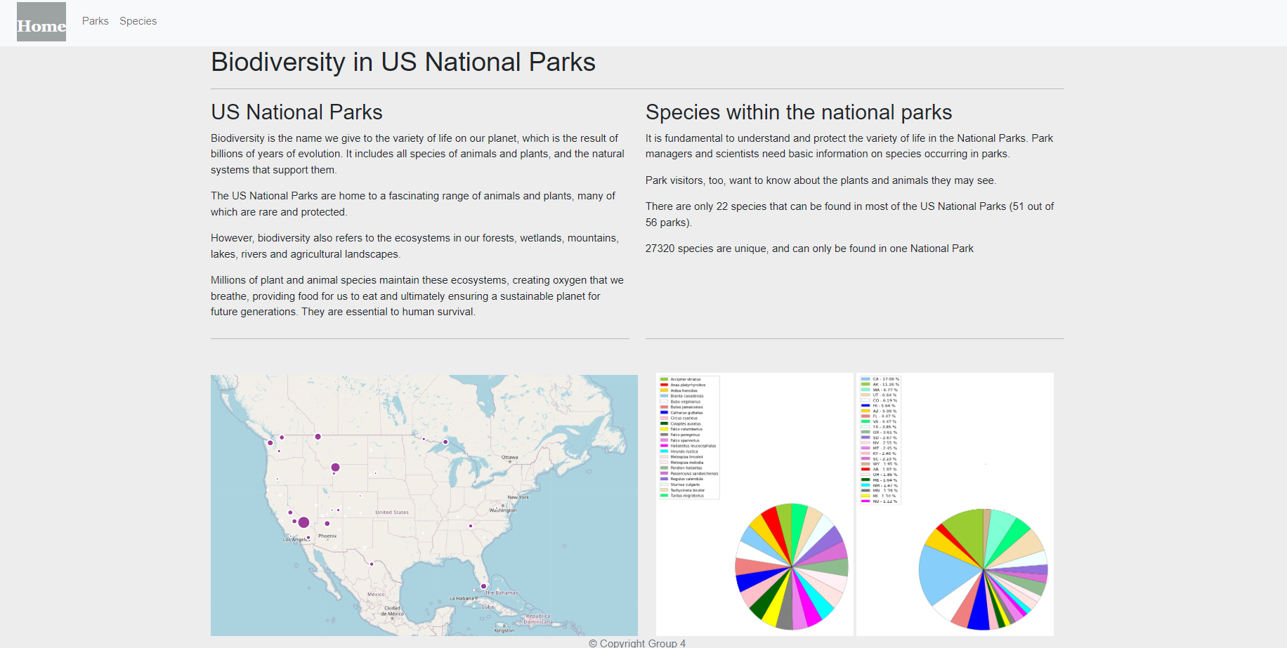
Home Page
Through the home page we can access the two other web pages: parks and species, where more info can be found
Notes:
Hibaa

Slide 10
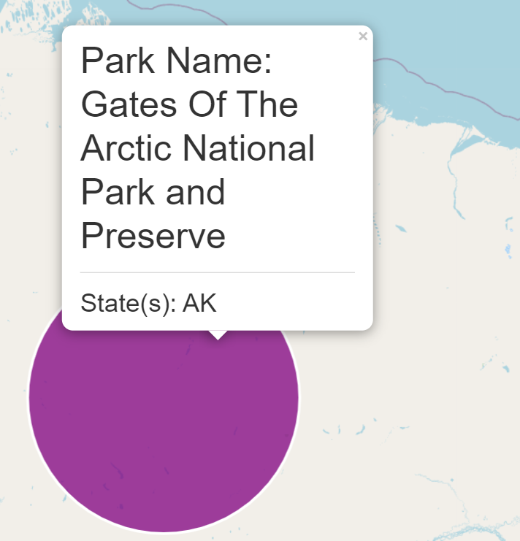
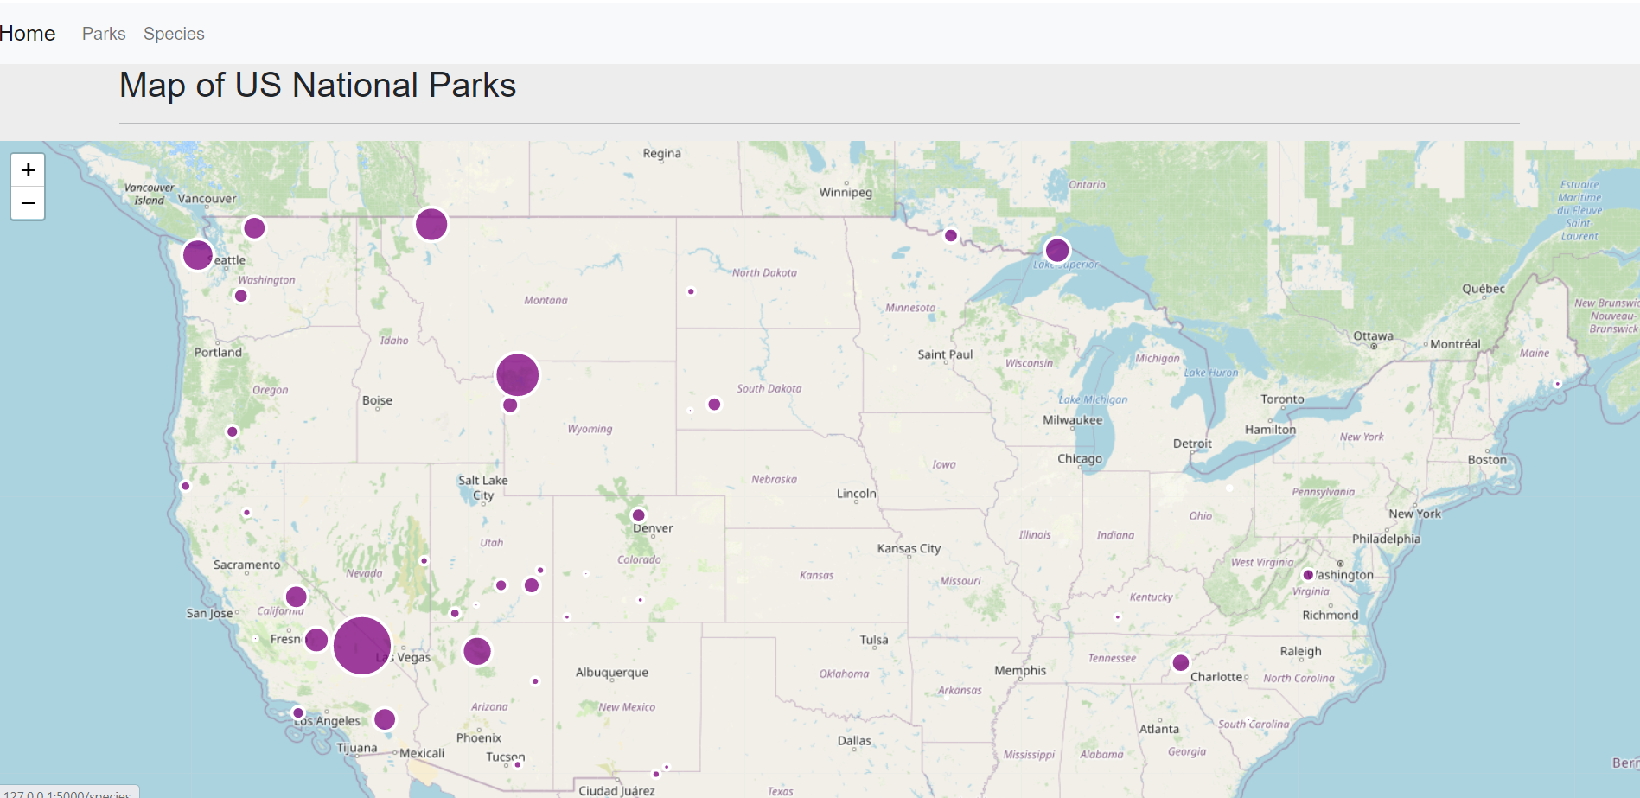
Parks Page
Interactive map of all the US National Parks.
The size of the circles is proportional to the size of each park.
Notes:
Patricia

Slide 11
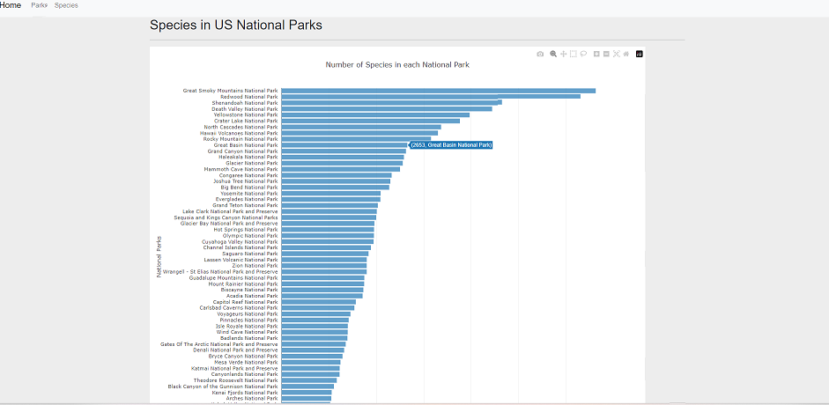
Species Page
Interactive bar chart with the number of species for each US National Park.
Notes:
Hibaa

Slide 12
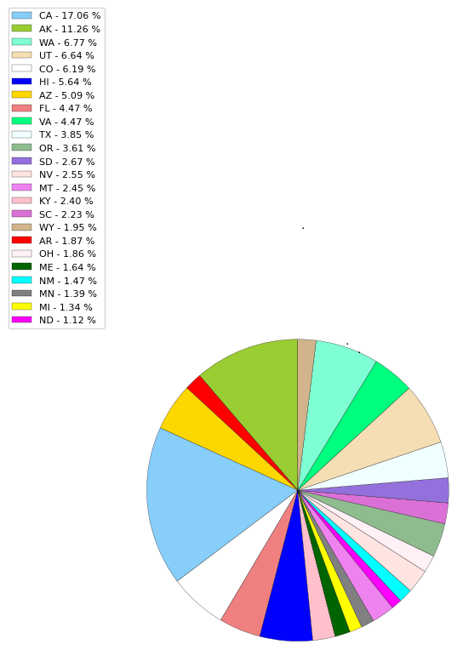
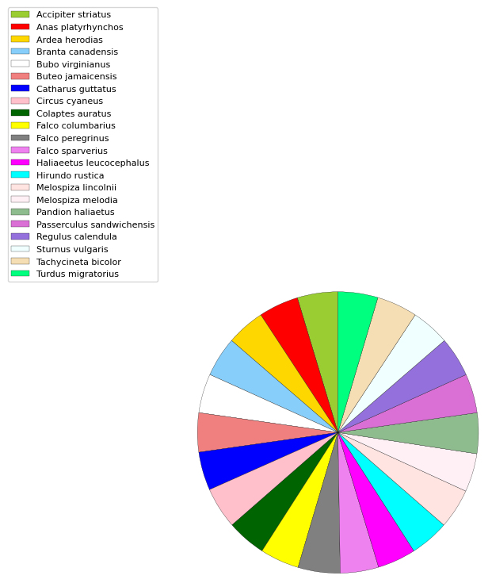
Visualizations
22 species can be found in 51 out of the 56 US National Parks
There are 27320 unique species that can only be found in one park.
California is the State with more biodiversity
Notes:
Patricia

Slide 13
CONCLUSIONS
There are 56 national park in USA biggest national park is (Gates Of The Arctic National Park and Preserve) and smallest national park is (Acadia National Park) .As we can see in pie chart California(CA) states have the highest biodiversity and second have Alaska(Ak)state and third is Washington state. Dry Tortugas National Park has lowest species and Great Smoky Mountains National Park has a highest species count. Falco peregrinus is the most common species it is present in 56 parks . Biodiversity is our life . it is our moral duty to conserve Biodiversity as well our Environment. Long –term maintenance of species and their management requires co-operative efforts across entire landscapes.
Notes:
Astha

Slide 14
Did you know…
1. The USA has a total of 56 National Parks altogether.
2. These Parks are spread across 30 different states around the USA
3. The US National Parks are home to a fascinating range of animals and plants, many of which are rare and protected.
4.Millions of plant and animal species maintain these ecosystem, and creates the oxygen that we breathe.
●
5.The plants and animals also provides us with the food that we eat and ultimately ensures a more sustainable planet for future generations.
Notes:
Abraham

Slide 15
Demo
Notes:
Abraham

Slide 16
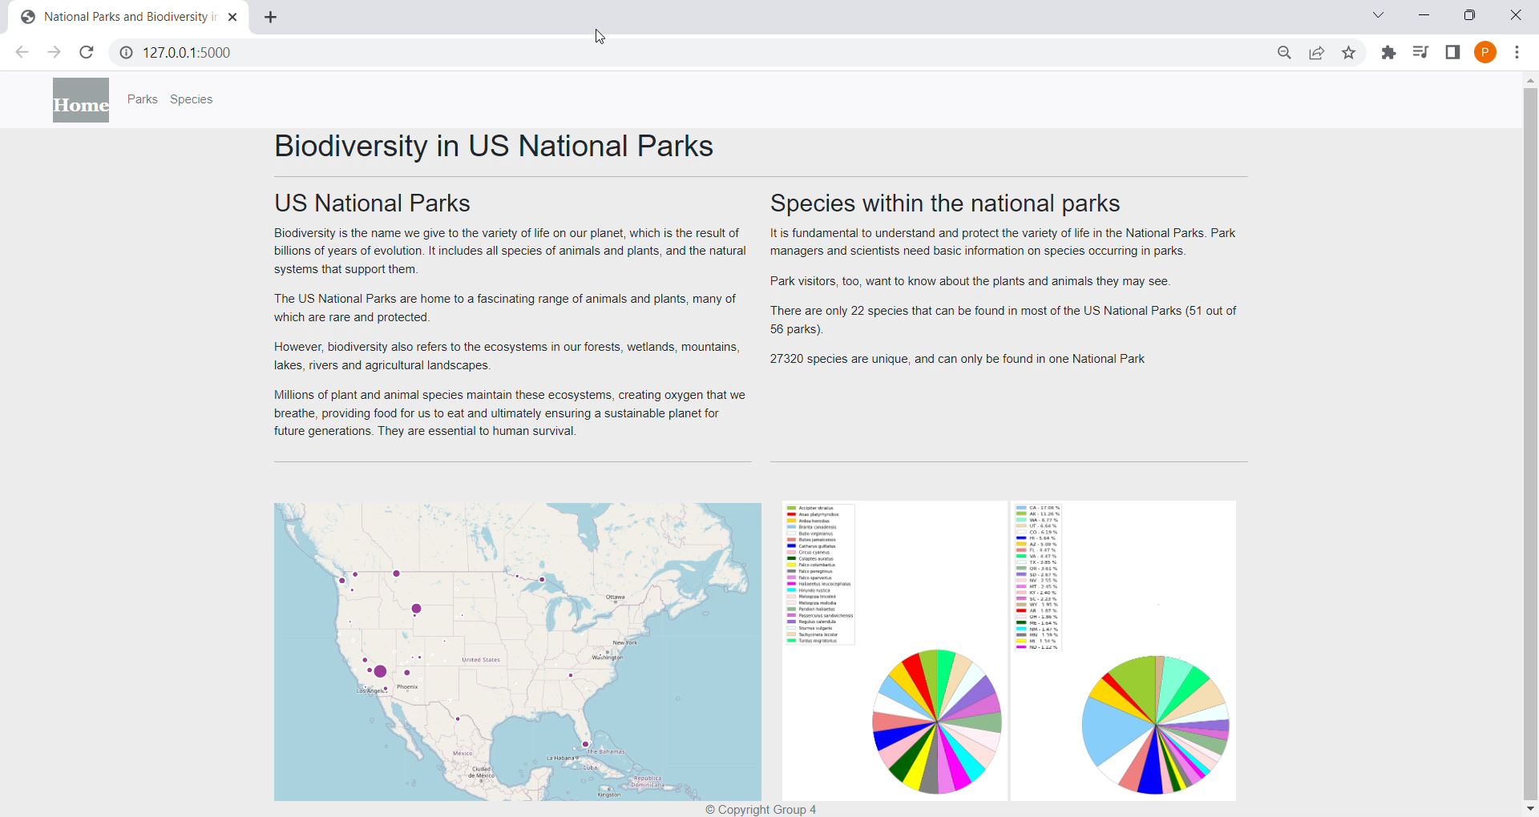

Slide 17
THANK YOU!
Group 4
Notes:
Samanthi

